Slide 1
Implementation of the Network Codes: ACER monitoring and SSE GRI state of play
Dennis Hesseling, Riccardo Galletta, ACER
21st Stakeholder Group meeting, SSE GRI
Bucuresti, 13 December 2016

Slide 2
Outline
Agenda
ACER’s monitoring activity
Congestion Management Procedures
Capacity Allocation Mechanisms
Balancing
Conclusion
DISCLAIMER: The opinions expressed in this presentation do not necessarily represent the official views of the Agency.
21st Stakeholder Group meeting, SSE GRI Bucharest, 13 December 2016

Slide 3
Moving to next phase in Network Code process
Monitoring
Implementation
Development
Activities
Drafting Framework Guideline
Drafting Network Code
Voting Network Code
Incorporating NC into national provisions
Applying national provisions
Data collection
Implementation analysis
Effects analysis
Drafting implementation monitoring report
Actors
ACER
ENTSOG
EC, Member States
NRAs
TSOs
ACER
ENTSOG
21st Stakeholder Group meeting, SSE GRI Bucharest, 13 December 2016

Slide 4


Legal background
The legal basis of NCs implementation monitoring
Art. 9.1 of Gas Regulation: ACER to monitor & analyse NCs/GL implementation + effect on harmonisation of applicable rules to facilitate market integration, non-discrimination, effective competition and effective functioning of the market and report to the EC
Art. 8.8 of Gas Regulation: ENTSOG to analyse & monitor NCs/GL implementation and their effect on the harmonisation of applicable rules aimed at facilitating market integration
Art. 8.9: make information available to ACER
21st Stakeholder Group meeting, SSE GRI Bucharest, 13 December 2016

Slide 5
Work-stream of implementation monitoring
An inclusive, articulated process
  Shared exercise between ACER and ENTSOG
    Questionnaires, on all topics (CMP, CAM, BAL) agreed
    Respondents: NRAs and/or TSOs
  Data analysis and calculation of indicators
    Data provided by ENTSOG Transparency team and downloaded from booking platforms
    Indicators calculated by ACER
  Agency’s reports published on:
    CMP: 21 September 2016
    CAM: 27 October 2016
    BAL: 7 November 2016
  The Agency is preparing the 2017 editions
21st Stakeholder Group meeting, SSE GRI Bucharest, 13 December 2016

Slide 6

CMP implementation in SSE EU MSs
CMP Implementation Monitoring (Update 2016 – status as of 6/2016):
FDA
FDA in the design phase
21st Stakeholder Group meeting, SSE GRI Bucharest, 13 December 2016

Slide 7
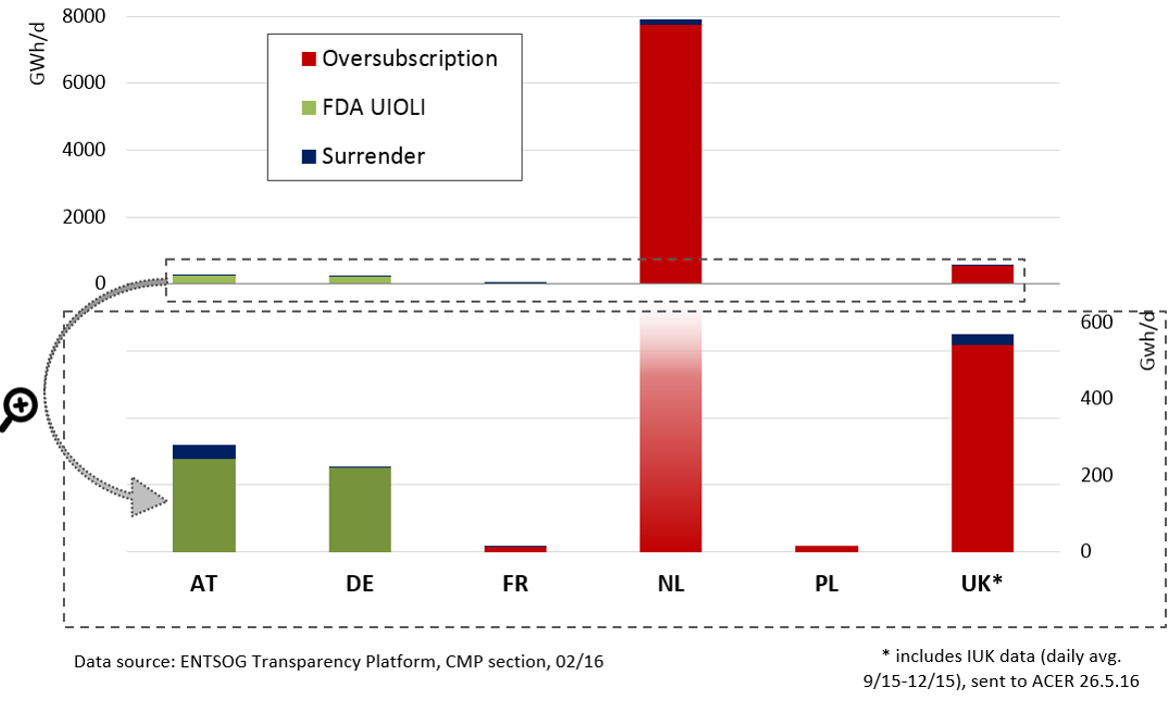
CMP capacity made available in 2015
21st Stakeholder Group meeting, SSE GRI Bucharest, 13 December 2016

Slide 8
Analysis of contractual congestion
Capacity made available and contractual congestion
  Beyond incomplete implementation and scarce application of CMPs
  the Agency’s analysis showed contractual congestion at certain IPs in the SSE region
The Agency, after the results of a call for evidence on congestion indicators, is considering to propose providing more flexibility to NRAs regarding FDA UIOLI application
21st Stakeholder Group meeting, SSE GRI Bucharest, 13 December 2016

Slide 9
CAM: implementation monitoring map
CAM implementation monitoring highlight
  Average overall implementation reaches 75% in SSE EU MSs
    rest of EU: 90%
  Only BG scores below 60%
21st Stakeholder Group meeting, SSE GRI Bucharest, 13 December 2016

Slide 10
CAM: implementation monitoring summary
21st Stakeholder Group meeting, SSE GRI Bucharest, 13 December 2016

Slide 11
CAM: implementation monitoring highlights
SSE EU MSs
No allocation on MA bundled capacity
21st Stakeholder Group meeting, SSE GRI Bucharest, 13 December 2016

Slide 12
Balancing: implementation monitoring summary
Implementation clusters: three different timings
21st Stakeholder Group meeting, SSE GRI Bucharest, 13 December 2016

Slide 13
Balancing: implementation monitoring summary
Average implementation rate by countries
At EU level, UK, FR, BELUX and DK reached implementation level of 85-100%
21st Stakeholder Group meeting, SSE GRI Bucharest, 13 December 2016

Slide 14
BAL NC: implementation of market enablers
Implementing of fundamentals requirements is not yet complete
: information to support market
development
: access to flexible gas
: access to network flexibility
21st Stakeholder Group meeting, SSE GRI Bucharest, 13 December 2016

Slide 15
Conclusion [1/2]
Summary of findings and conclusions on IMRs in SSE EU
CMP
Mechanisms implemented, except in a few MSs
Limited CMP application → not much capacity made available via CMPs
Contractual congestion is still present in the region
CAM
Overall high implementation level (except BG)
Improvement needed on dynamic recalculation and bundling
Some MSs need to complete the implementation of provisions on interruptible capacity
21st Stakeholder Group meeting, SSE GRI Bucharest, 13 December 2016

Slide 16
Conclusion [2/2]
Summary of findings and conclusions on IMRs in SSE EU
BAL
Concentrate implementation efforts on market enablers
Implementation levels can improve considerably in some MSs
Balancing/Trading Platforms shall be created, where missing
Interim measures have time limits, as follows:
  Only Balancing Platforms can go beyond 2019 April;
  Tolerances, interim prices cannot apply beyond 2019. These tools can support market development now and not later. If balancing regimes miss several design elements, these supporting tools would contribute less to the development of the short term markets, as intended.
OVERALL
The NC implementation in SSE GRI MSs is weaker than in other EU MSs (with important delays in BG, EL and RO)
Knowledge sharing and increasing dialogue in the EU may facilitate effective implementation
21st Stakeholder Group meeting, SSE GRI Bucharest, 13 December 2016

Slide 17

Thank you for your attention!
www.acer.europa.eu
21st Stakeholder Group meeting, SSE GRI Bucharest, 13 December 2016

